Slide 1
Unified mentor Front-End Development Internship :
Tic-Tac-Toe
My Portfolio
Weather App
To-Do App
Basic Calculator
Recipe Book
Music Player
Interactive Resume
Info
Graphics
Virtual Pet Simu
This presentation showcases web development project: My Blog Website .This project utilize HTML, CSS, and JavaScript, demonstrating my coding skills and project development experience. This project highlight my ability to create interactive and engaging web applications, showcasing my passion for web development and commitment to building high-quality, user-friendly website.
A Web Development Showcase
Memory Card Game
Interactive Quiz
Countdown Timer
Blog Website
Virtual Art gallery
by Mandadi Rohit Reddy
Internship ID: UMIP278665
M R
Chat Application
Interactive Story telling
Interactive Map
Image Slider
Expense Tracker

Slide 2

My Blog Website Project in HTML,CSS and JS
by Mandadi Rohit Reddy
Internship ID: UMIP278665

Slide 3

Introduction
The Blog Website Project is a fully responsive, interactive platform built using core web technologies—HTML, CSS, and JavaScript. This project aims to replicate a clean, modern blogging experience where users can explore articles, read posts, and interact with dynamic elements.
The website features:
A sleek and minimalist homepage showcasing recent blog posts
A fully designed post view page for detailed reading
A navbar for seamless navigation across different categories
Responsive layout for desktops, tablets, and mobile devices
Interactive components like read more toggles, modal popups, or theme switching
Through this project, I enhanced my frontend development skills, deepened my understanding of DOM manipulation, and improved my ability to create user-friendly interfaces using vanilla JavaScript without relying on external frameworks.

Slide 4

✅ Key Features
Responsive Design – Optimized layout for mobile, tablet, and desktop screens
Dynamic Blog Post Rendering – Blog content displayed dynamically using JavaScript
Navigation Bar – Sticky and responsive navbar for smooth navigation
Post Preview with “Read More” Toggle – Expandable sections to read full content
Search Functionality (optional) – Filter blog posts based on keywords
Dark/Light Theme Toggle (optional) – Switch between dark and light modes
Smooth Scroll Effects – Better user experience with smooth page transitions
Contact Section / Footer – Includes links, contact form, and social media icons

Slide 5

🛠️ Technologies Used
HTML5 – Structure of the blog pages
CSS3 – Styling with Flexbox, Grid, media queries, transitions, and animations
JavaScript (Vanilla JS) – DOM manipulation, event handling, theme toggling, filtering
Font Awesome / Google Fonts (optional) – For icons and typography
Responsive Design Principles – Mobile-first approach using CSS media queries
Git & GitHub – Version control and project hosting

Slide 6
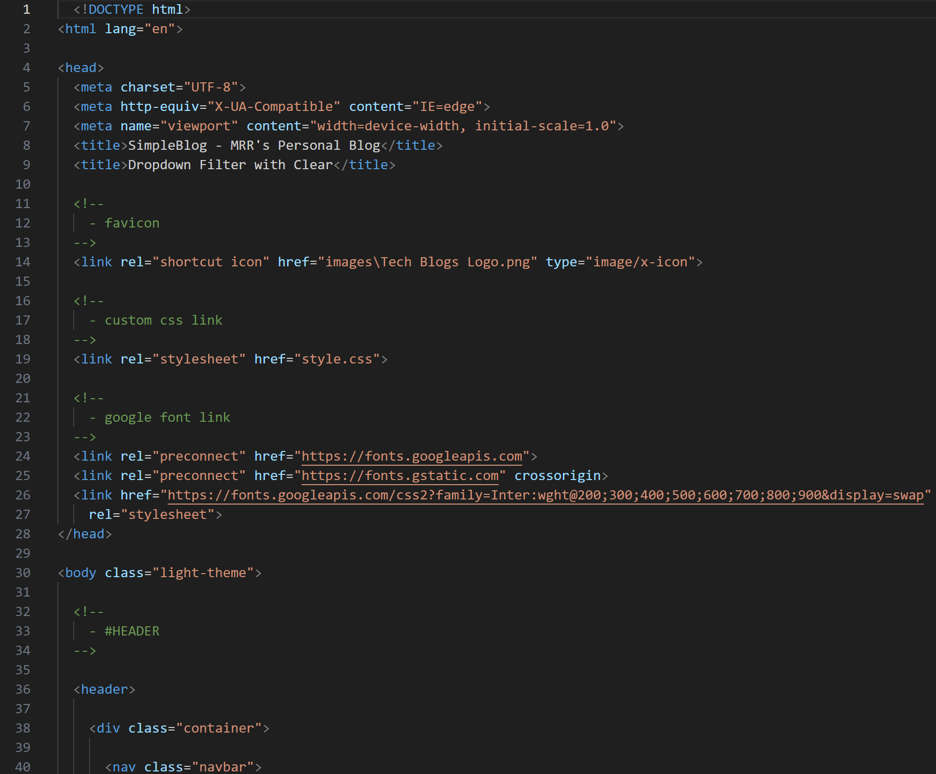
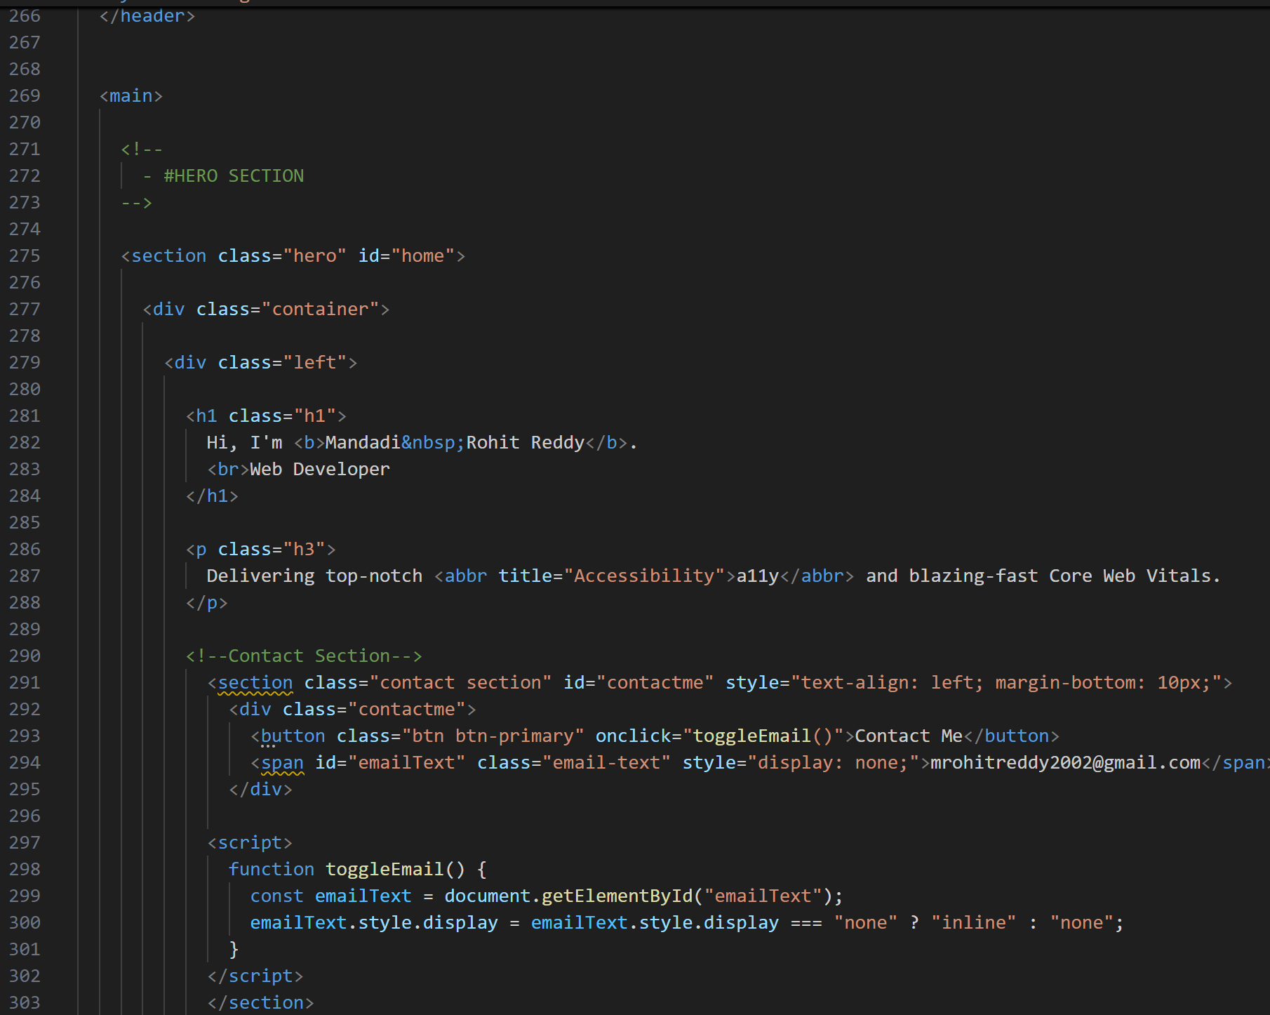
HTML5 – Structure of the blog pages

Slide 7
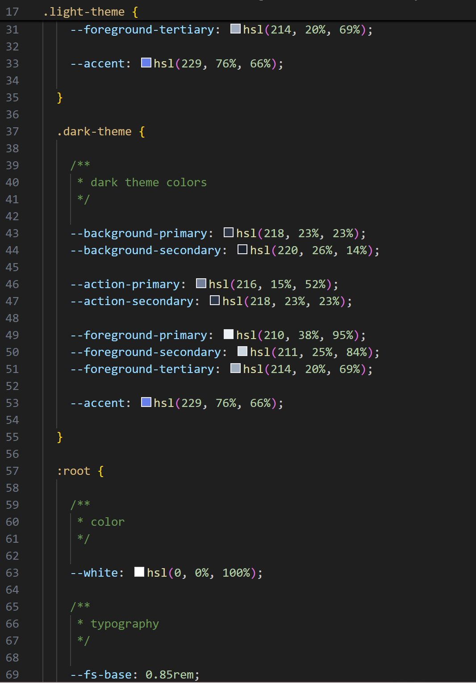
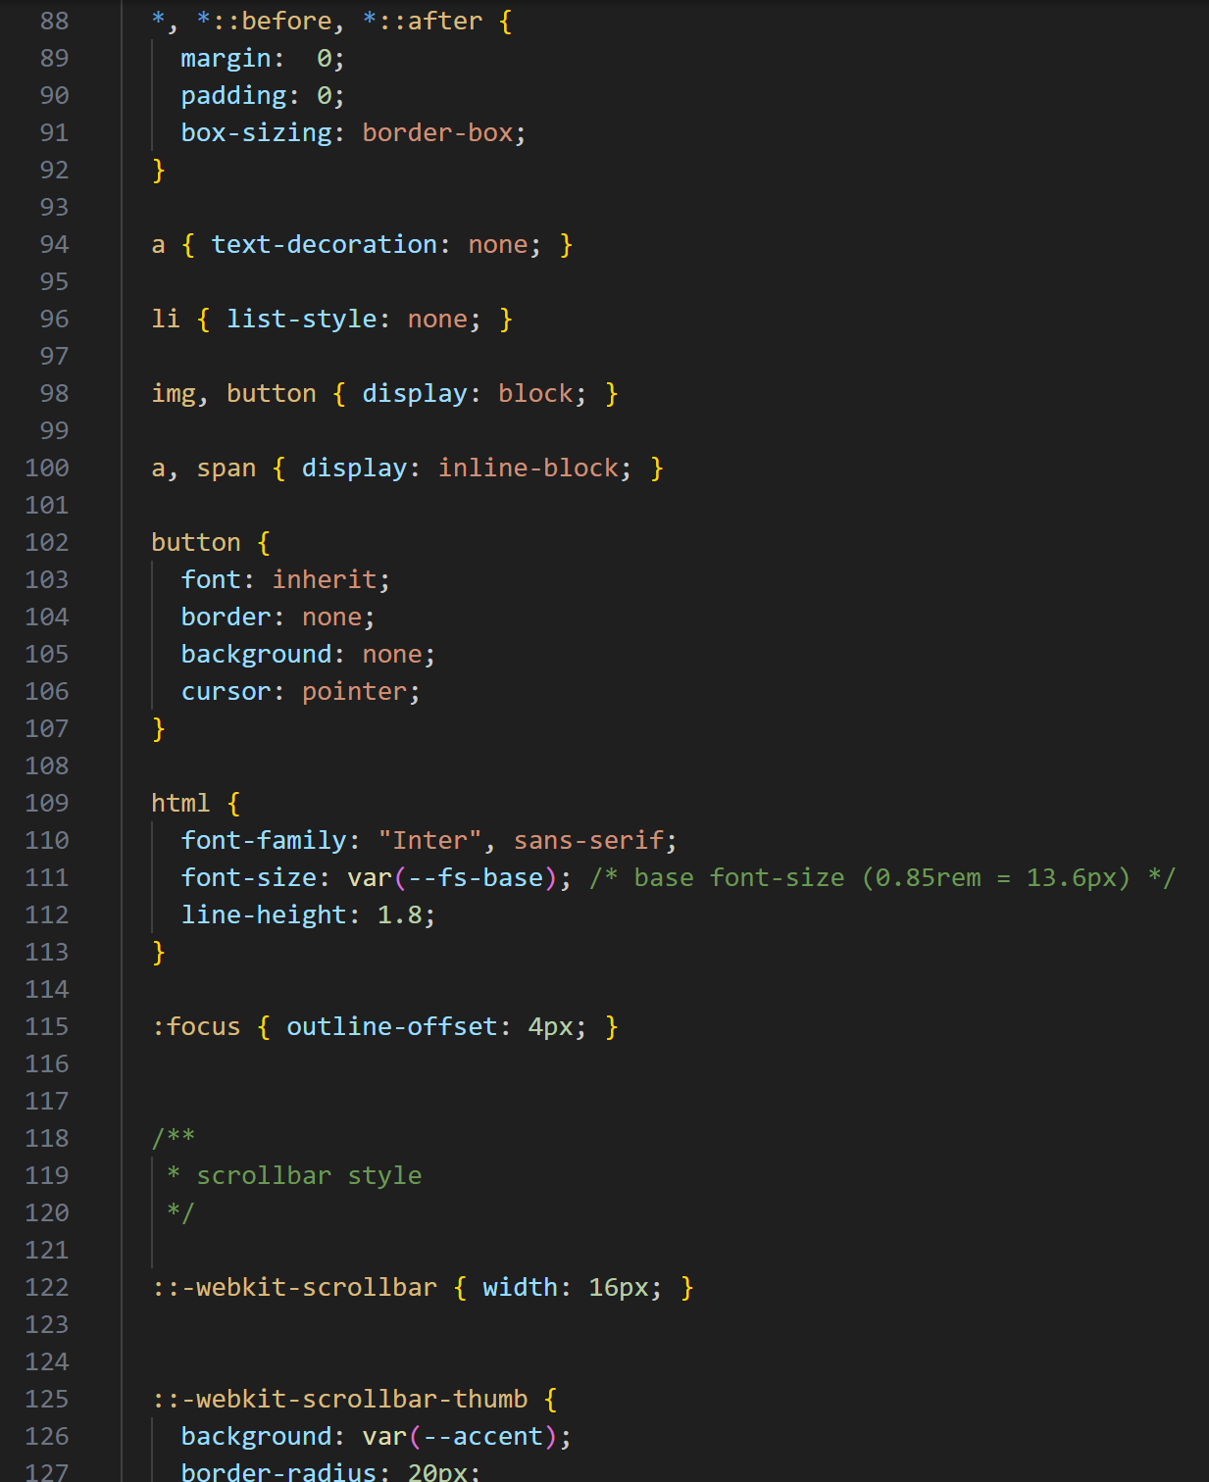
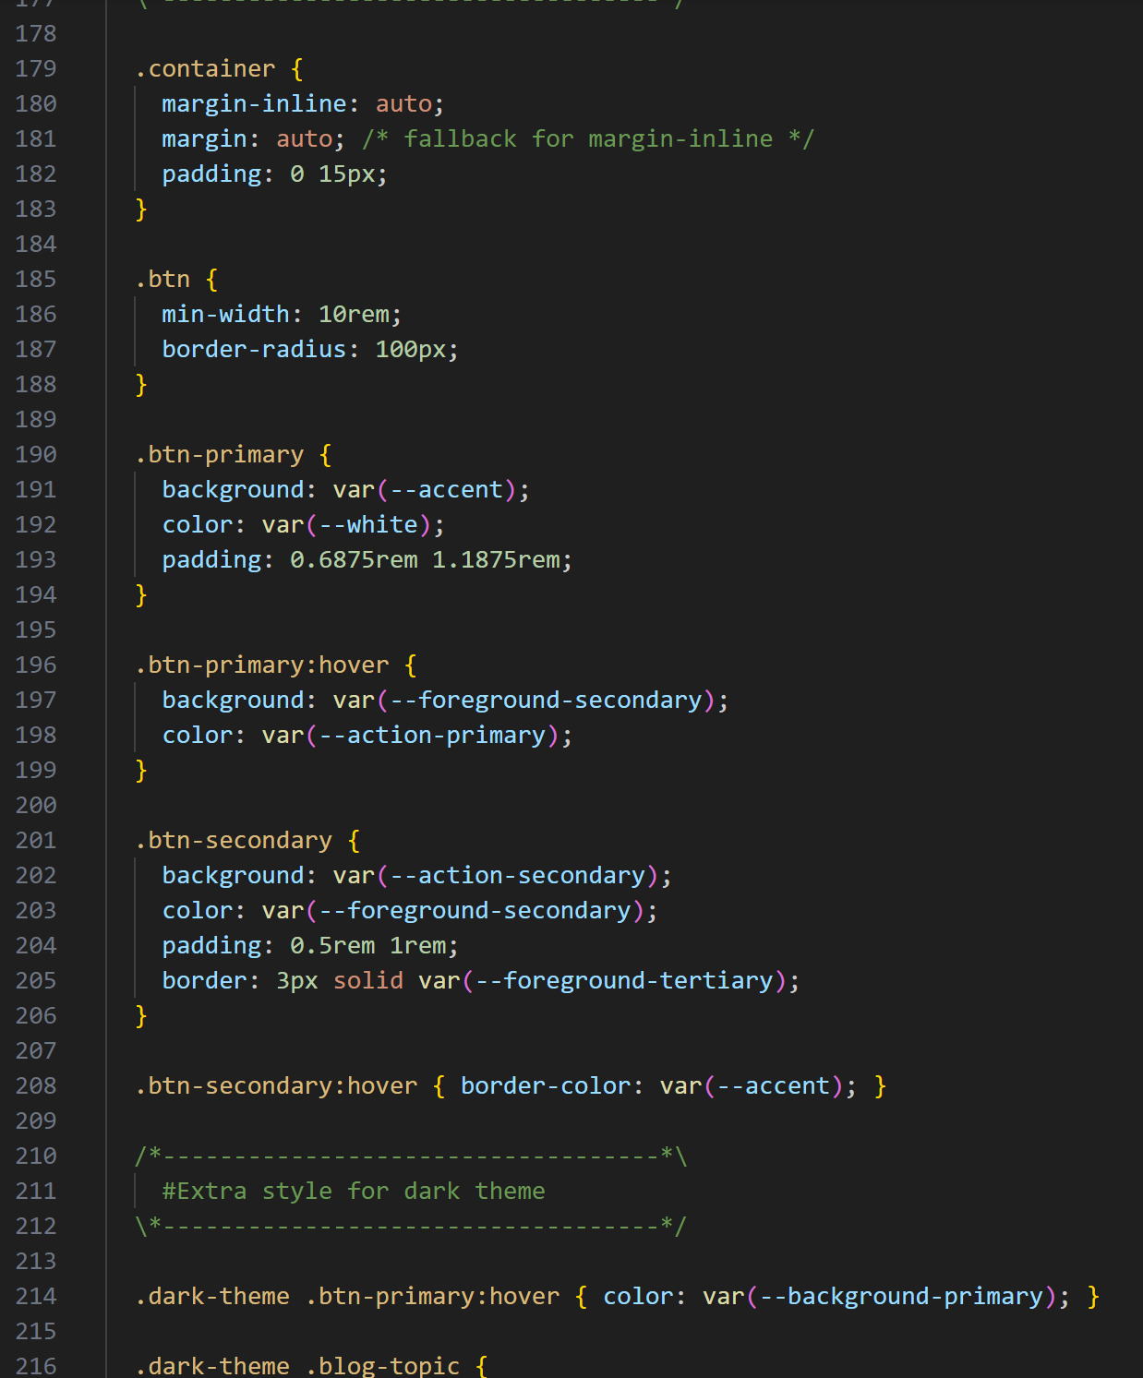
CSS3 – Styling with Flexbox, Grid, media queries, transitions, and animations

Slide 8
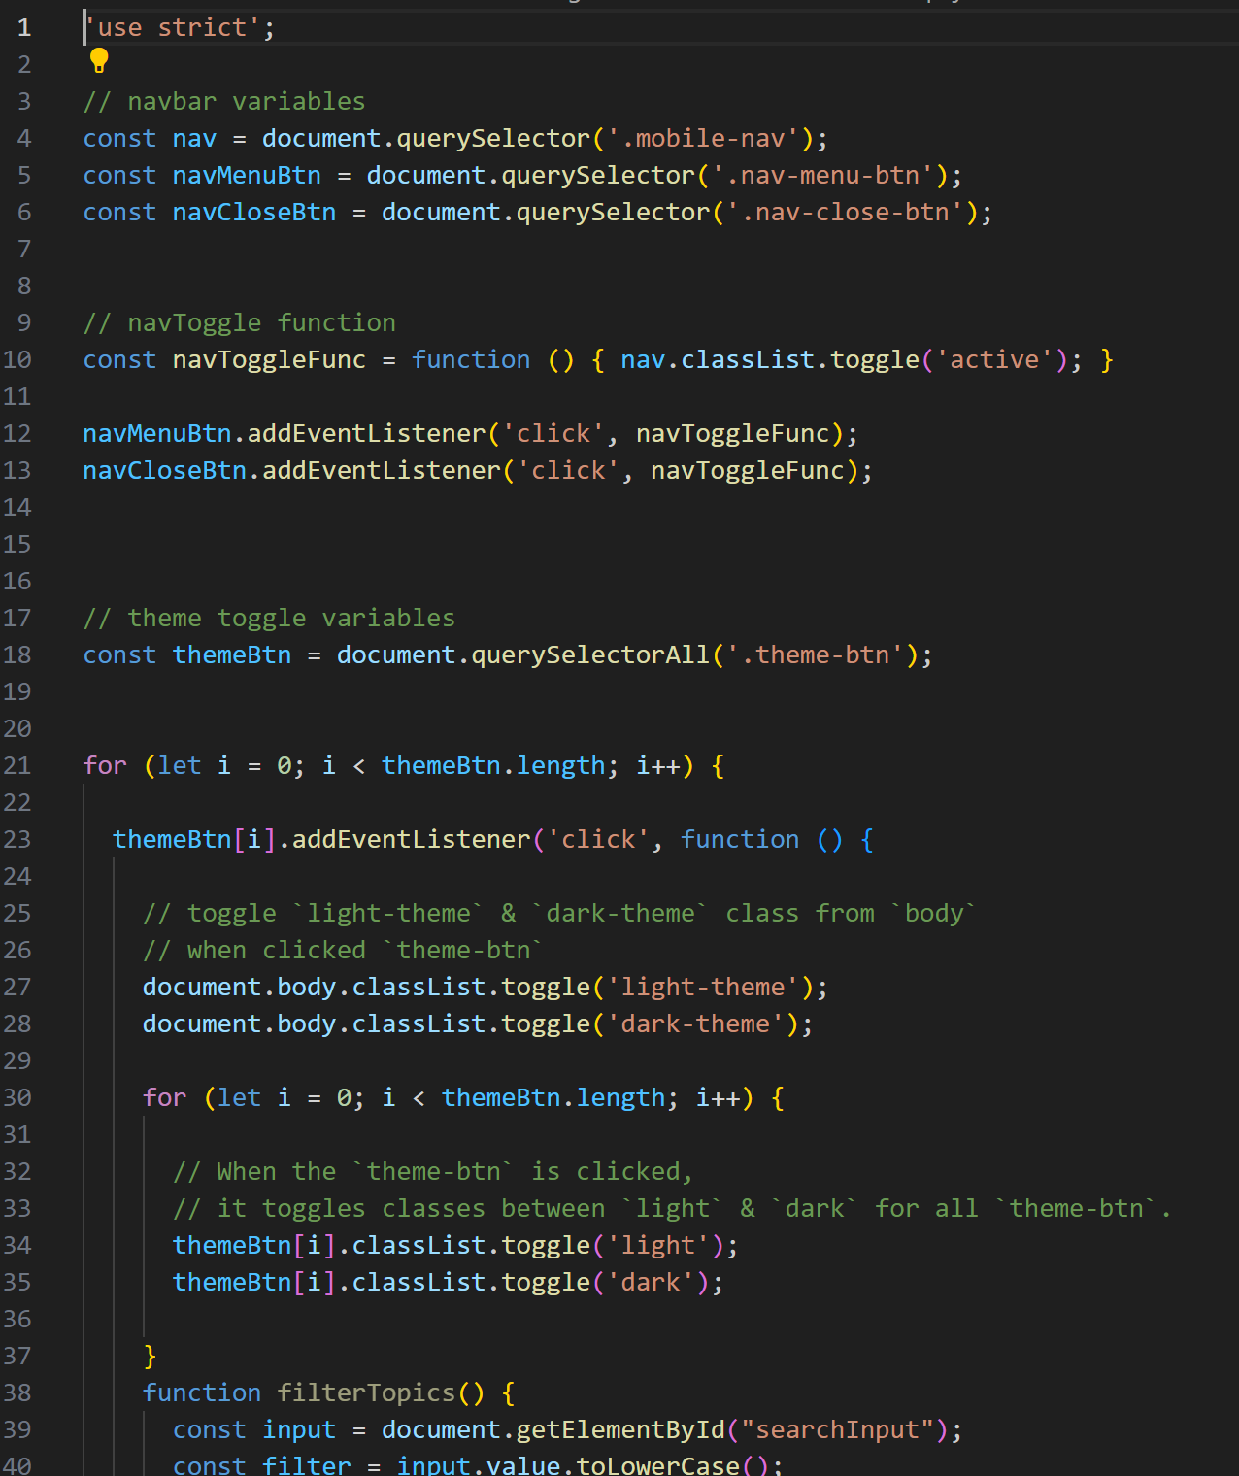
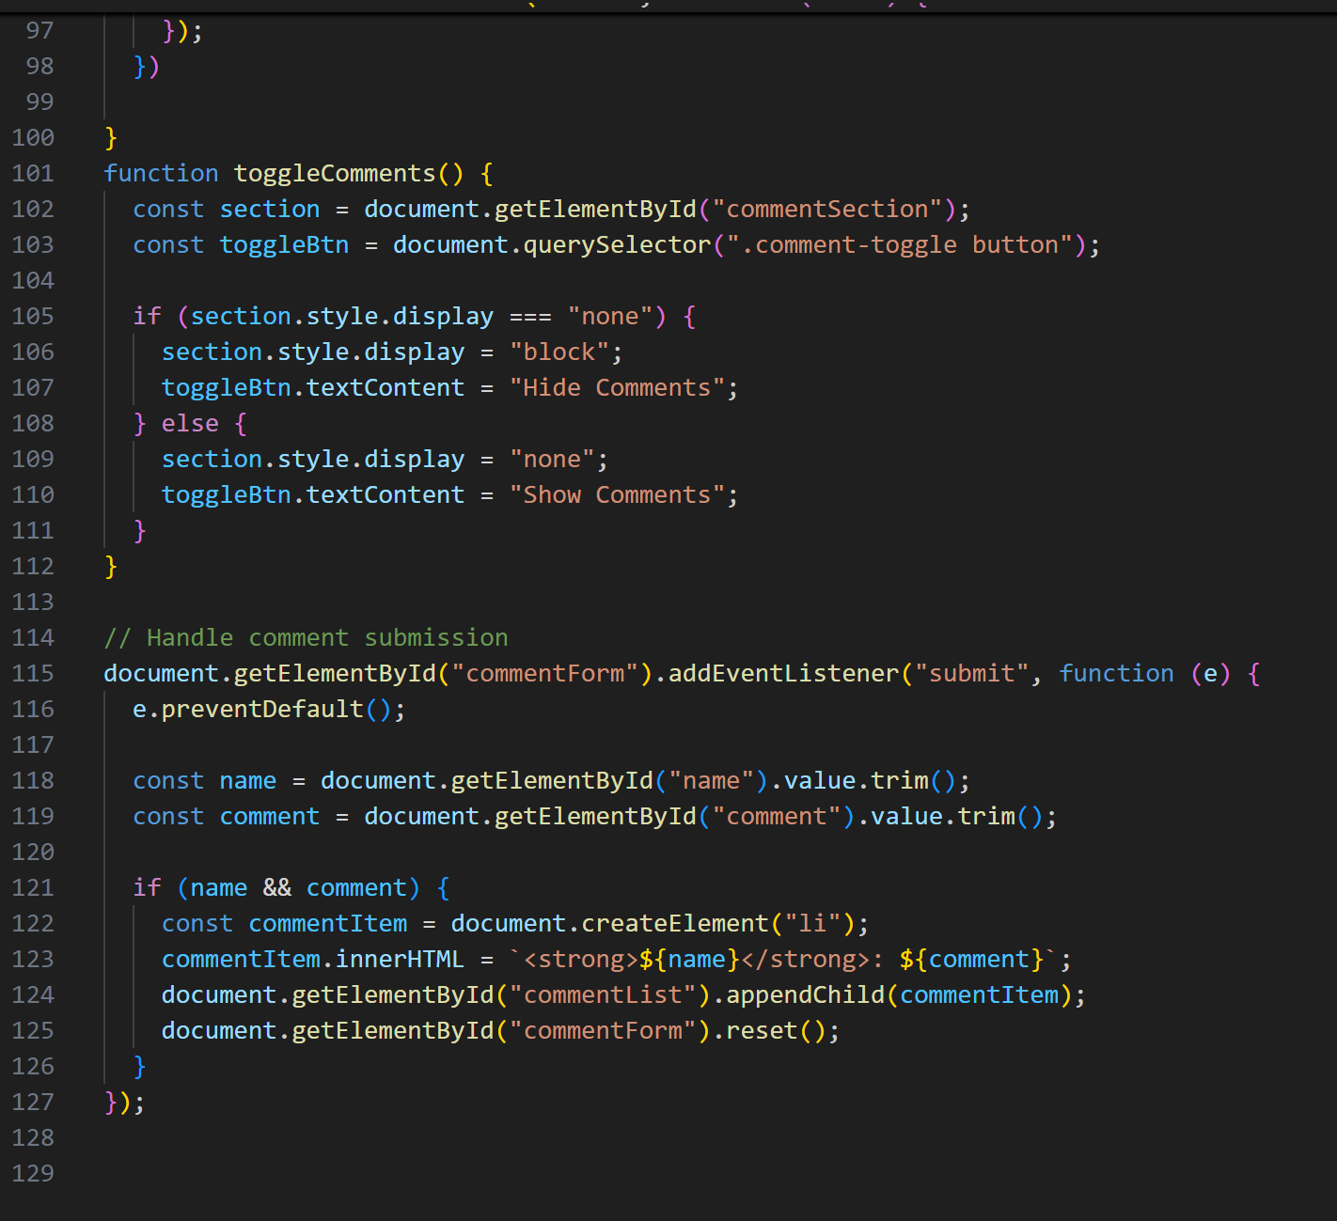
JavaScript (Vanilla JS) – DOM manipulation, event handling, theme toggling, filtering

Slide 9
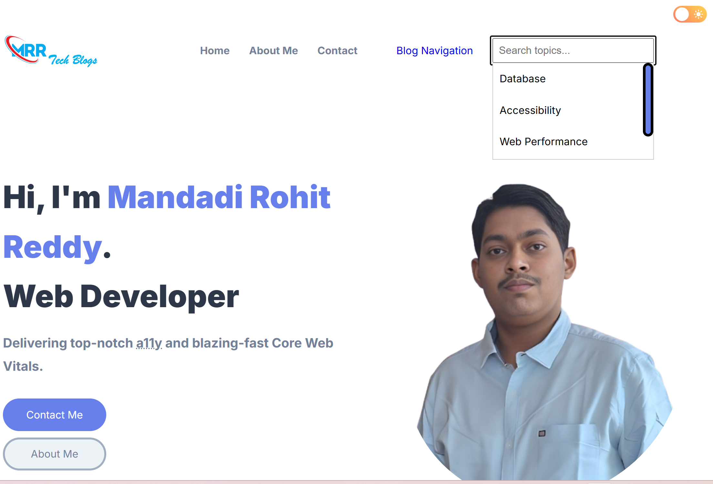
Project Output:

Slide 10
Social Website Link:
Website Link: https://lambent-nougat-6dd12d.netlify.app/
GitHub Link: https://github.com/Mandadi2002/Unified-Mentor-FED/tree/main/Project-14%20Blog

